Slide 1
What’s In A Pitch?
Insights from PITCHf/x

Slide 2
Introduction
PITCHf/x is a pitch-tracking system installed in every Major League Baseball (MLB) stadium. Cameras track pitch movement, and MLB Advanced Media makes that data (and more) publicly available.
PITCHf/x permits a finer-grained analysis of pitching, with breakdowns of velocity, movement, spin, and location.

Slide 3
The Data
Brooks Baseball (http://www.brooksbaseball.net/) provides a hand-corrected version of the PITCHf/x data. I found a Scrapy-based project on GitHub (https://github.com/mattdennewitz/mlb-brooks-pitch-importer) to download the data.

Slide 4
The Data
Every pitch thrown in every game between 2010 and 2015
Date, park, players, position, spin, velocity, strike zone dimensions
Pitch type
A LOT OF DATA

Slide 5
Preprocessing
Filtering of rare pitcher-batter ‘matchups’
1 matchup = 1 pitch thrown by Pitcher P to Batter B
Only events involving players with >= 30 matchups in the data were kept
Noise reduction
Factorization of categorial columns

Slide 6
Modeling
3 Classes (Hit, Strike, Ball)
Heterogenous data
Answer: Random Forests

Slide 7
Modeling
Aside: I looked into SVMs, but they took so long to train that they weren’t considered in depth.

Slide 8
Analysis & Results
Goal: determine what aspects of a pitch are most important to the outcome.
Plan: consider different groups of features, progressively informing models to increase predictive power. We’ll infer the importance of features by inspecting the weights our models assign to them, as well as the success of those models.

Slide 9
Analysis & Results
We use F1 as a scoring metric because it balances precision and recall and handles multiple classes well.
Since the focus is on the features as opposed to sheer predictive power, we will construct all our models with the same parameters.

Slide 10
Analysis and Results
Model I: “Pre-pitch” data – what could be reasonably inferred before the ball leaves the pitcher’s hand (but including release position).
Columns: ab_count, pitcher_id, batter_id, factorized_stand, strikes, balls, factorized_p_throws, x0, y0, z0, factorized_park

Slide 11
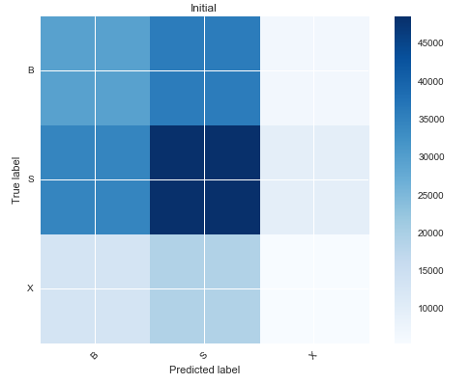
Analysis & Results – Model I
Results: Not good!
F1: 0.413
Note the underclassification of strikes–it’s a persistent theme.

Slide 12
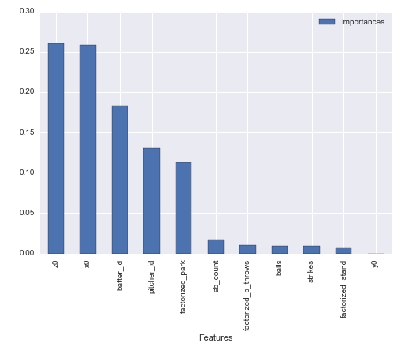
Analysis & Results – Model I
Features importances aren’t too informative given our lousy F1 score, however:
batter_id is more informative than pitcher_id
z0 (initial vertical position) is more informative than x0 (initial horizontal position)

Slide 13
Analysis & Results
Model IIa: PITCHf/x + Initial
Columns: Columns from Model I, plus sz_top, sz_bot, spin, pfx_x, pfx_z, start_speed, vx0, vz0, vy0, ax, ay, az

Slide 14
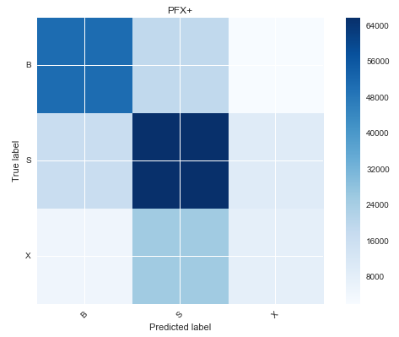
Analysis & Results – Model IIa
Results: Better!
F1: 0.616

Slide 15
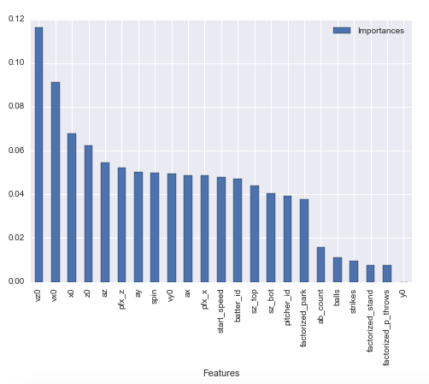
Analysis & Results – Model IIa
There’s been some shuffling–vz0 (initial vertical velocity) outranks vx0, but x0 beats out z0, in contrast to our previous model.
Notice also that the Pfx data is on balance more informative.

Slide 16
Analysis & Results
Model IIa – PITCHf/x Only
Columns: Only the PITCHf/x columns, without the initial data.

Slide 17
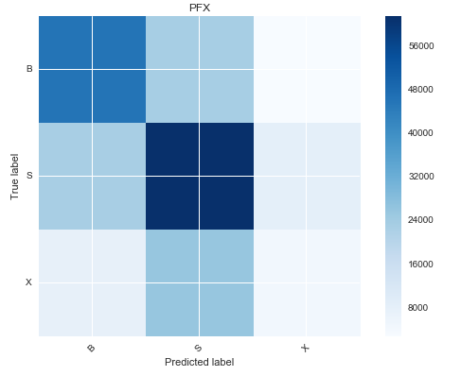
Analysis & Results – Model IIb
Results: Only slightly worse!
F1: 0.553
Weights essentially unchanged, reinforcing our suspicions about the relative importance of PITCHf/x data vs our initial data.

Slide 18
Analysis & Results
Model III: Pitch type
Columns: Initial data + factorized_mlbam_pitch_name
MLBAM labels every pitch with a RNN; Brooks hand-corrects it when necessary. Theoretically, this captures most of our PITCHf/x data–but does it?

Slide 19
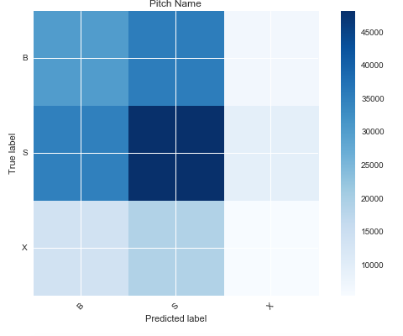
Analysis & Results – Model III
Results: Not really?
F1: 0.414

Slide 20
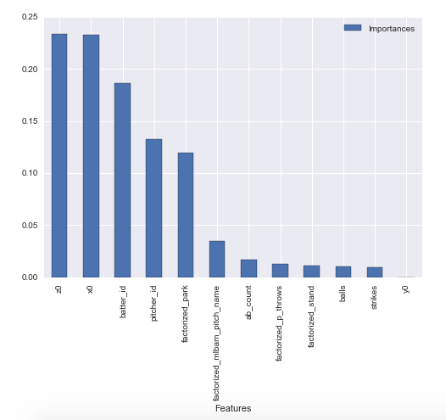
Analysis & Results – Model III
Even more damning: pitch type is less informative, according to our model, than several of our previously-used features.

Slide 21
Analysis & Results
Certain factors are consistently low-weighted, across models. We can train some models without these to measure their impact.
Model IVa: Initial - worst-performing columns

Slide 22
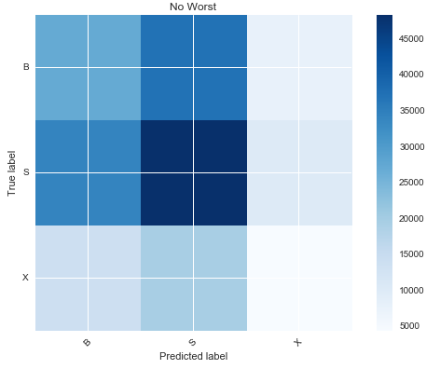
Analysis & Results – Model IVa
Results: Not great, but that’s to be expected with only 5 factors to consider.
F1: 0.395

Slide 23
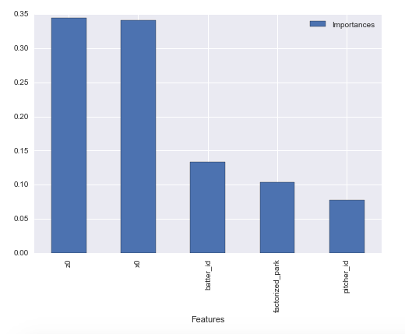
Analysis & Results – Model IVa
No real surprises here.

Slide 24
Analysis & Results
Model IVb: Pfx + ‘best’

Slide 25
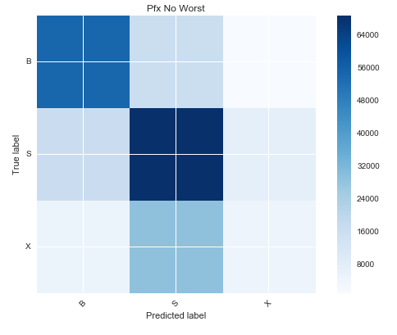
Analysis & Results – Model IVb
Results: our best model yet!
F1: 0.632
Suggests more conclusively that our ‘worst-performing’ columns are useless at best, slightly harmful at worst.

Slide 26
Analysis & Results
Model Va: “Cheating”
Columns: px, pz, norm_ht, factorized_zone_location
px and pz are the horizontal and vertical position of the ball as it crosses home plate; norm_ht is another vertical measure, factorized_zone_location abstracts over both.

Slide 27
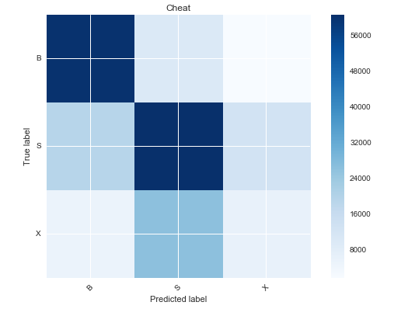
Analysis & Results – Model Va
Results: Expectedly good!
F1: 0.628
These 4 columns predict roughly as well as all our previous columns.

Slide 28
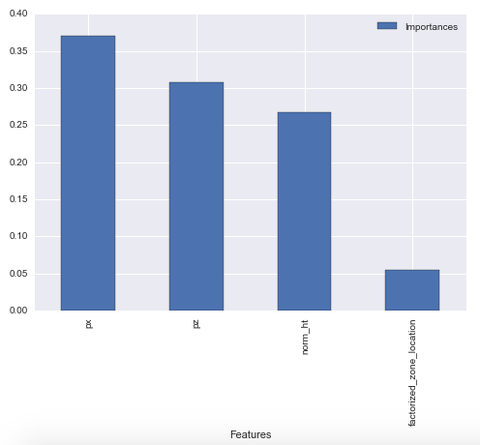
Analysis & Results – Model Va
Notice how unimportant factorized_zone_location is–like mlbam_pitch_name, finer-grained factors are clearly more informative.

Slide 29
Analysis & Results
Model Vb, Model Vc: “Cheat”+
Vb: “Cheat” + Initial
Vc: “Cheat” + “best”

Slide 30
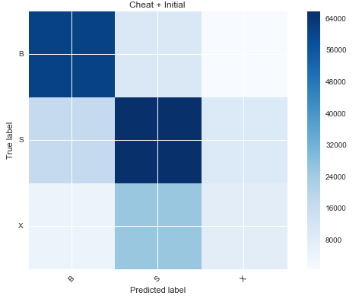
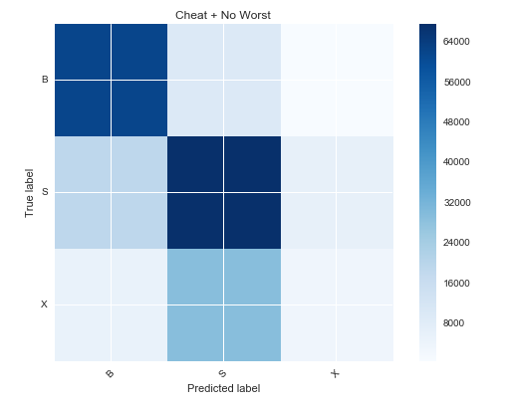
Analysis & Results – Model Vb, Vc

Slide 31
Analysis & Results – Model Vb, Vc
Vb F1: 0.665
Vc F1: 0.656

Slide 32
Analysis & Results
Model VI: “All” columns

Slide 33
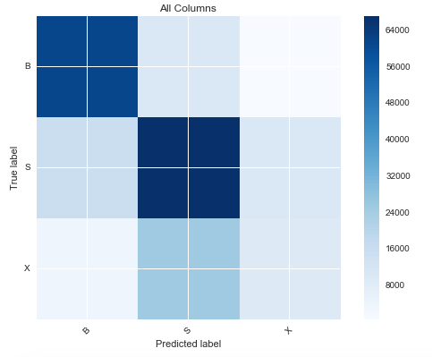
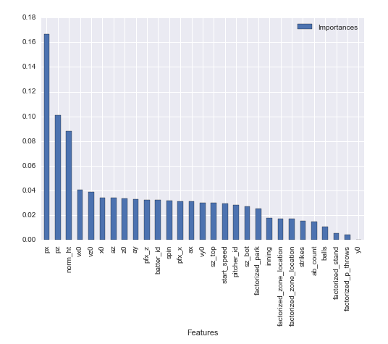
Analysis & Results – Model VI
F1 Score: 0.678

Slide 34
Analysis & Results
Model VII: Cheat Harder
ab_total represents the total number of events in the at-bat. It hasn’t been included because it’s not strictly “about” the individual pitches, but rather the at-bat as a whole. It’s also incredibly helpful.

Slide 35
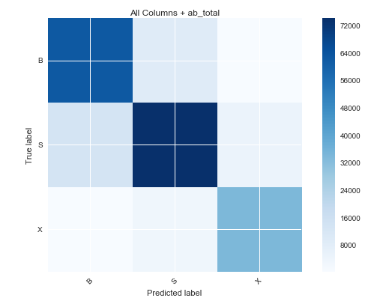
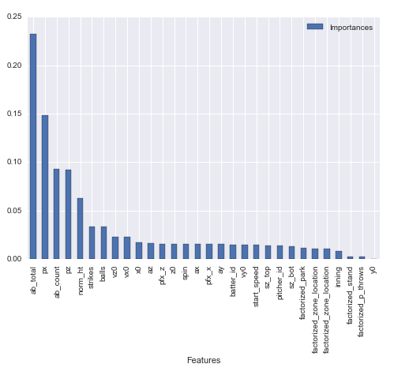
Analysis & Results – Model VII
F1: 0.843 (!)

Slide 36
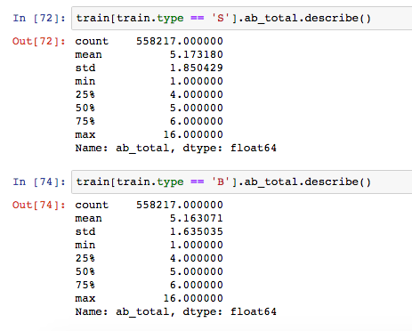
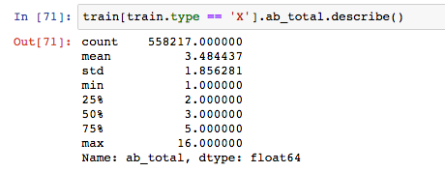
Analysis & Results
At-bats that end in a hit are significantly shorter than those that don’t!

